Slide 1
Generative Adversarial Networks

Slide 2
Contents
Generative Modeling
GAN
Applications of GAN
Components of GAN
Training of GAN
Loss Functions of GAN

Slide 3
Generative Modelling
Unsupervised Learning Approach
It’s about creating/ generating/ producing
It’s pretty hard compared to other deep learning fields
Classification is much easier rather than create a sensible data/image/ text.

Slide 4
GAN
Released in 2014
Generative: Generator/Creator/ Producer
Adversarial: Checker/investigator/Opposition Party
We have to make this fool
Network: Neural Network

Slide 5
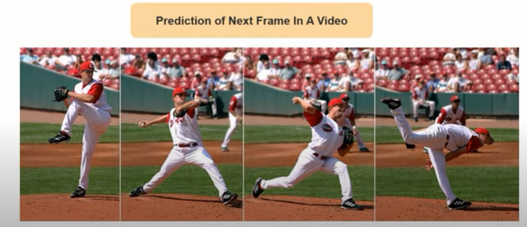
GAN Applications

Slide 6
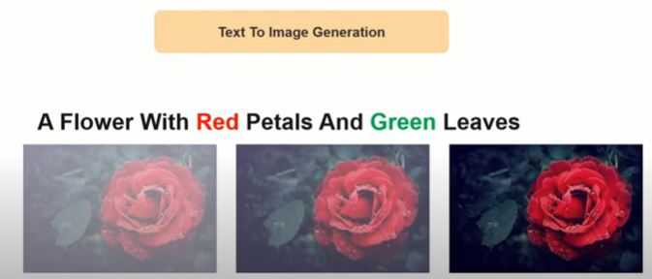
GAN Applications

Slide 7
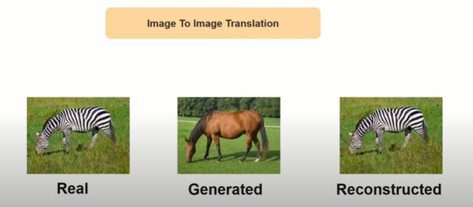
GAN Applications

Slide 8

GAN Applications

Slide 9
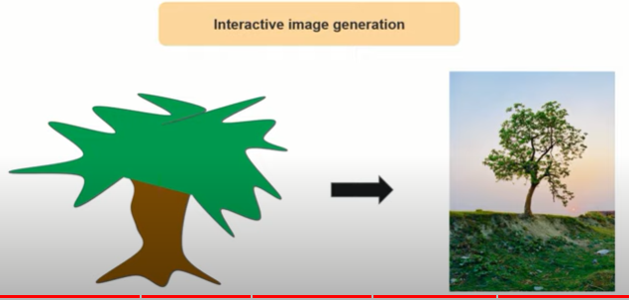
GAN Applications

Slide 10
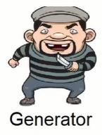

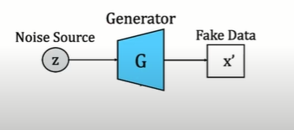
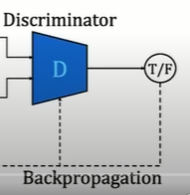

Components of GAN

Slide 11
Components of GAN
Generator works on an unsupervised learning approach
Generator will generate the data(fake image).
Discriminator works on a supervised learning approach
Discriminator does classification. It will predict whether the image is fake or real

Slide 12
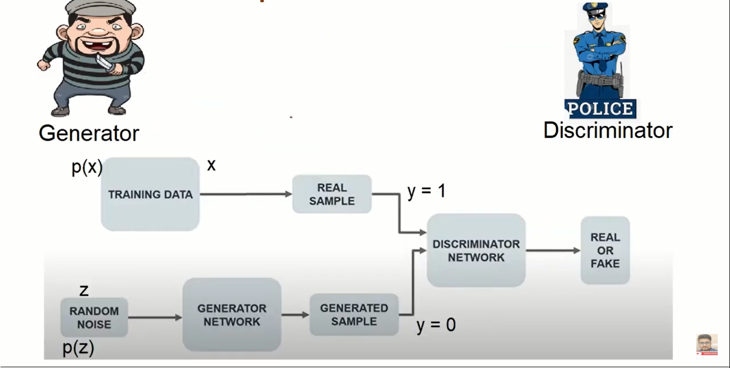
Components of GAN
Notes:
P() probability distribution

Slide 13
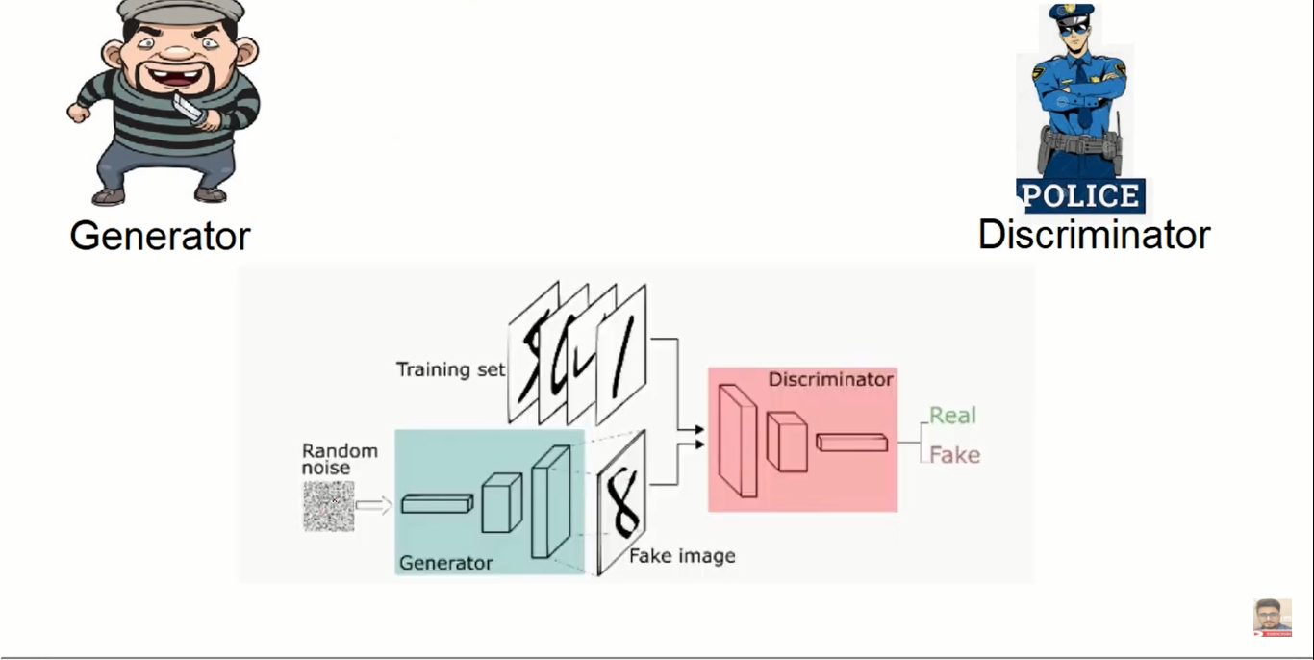
Components of GAN
Notes:
P() probability distribution

Slide 14
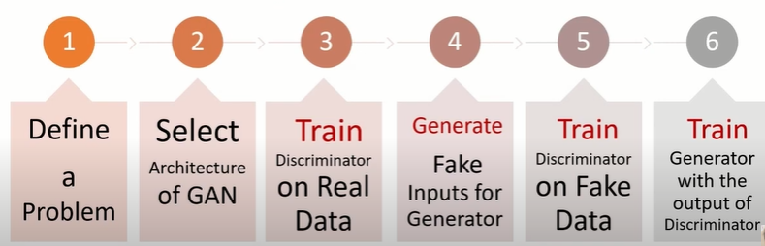
Training of GAN
Notes:
P() probability distribution

Slide 15
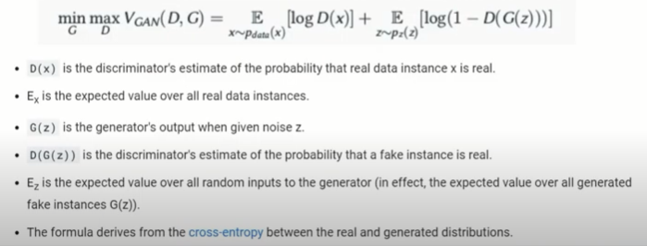
GAN Loss Function
Generator tries to minimize the following function and the discriminator tries to maximize it.
Notes:
P() probability distribution

Slide 16
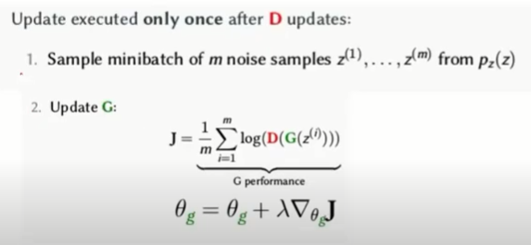
Training of Discriminator
Notes:
P() probability distribution

Slide 17
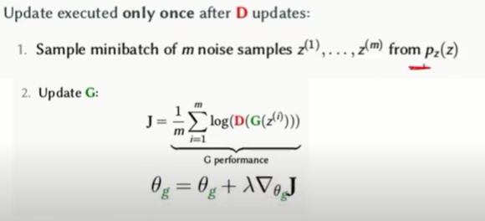
Training of Generator
Notes:
P() probability distribution

Slide 18
Challenges faced by GAN
Problems of stability between generator and discriminator. Discriminator should not be strict as main goal of GAN is to predict real.
Problem to determine positioning the objects. Eg input image has 3 horses and generator will generate an image having one horse with six eyes.
Notes:
P() probability distribution

Slide 19
References https://www.youtube.com/watch?v=i2q0iwNSNAw https://www.youtube.com/watch?v=5g1eXmQtl0E

Slide 20
Thank You

